Slide 1
For Part 9 Buildings
Jane Smith President,
Company Name Here

Slide 2
The Provincial Context
Notes:
The BC Energy Step Code is a performance standard that is designed to drive steady increases in energy efficiency in new construction.
Local governments in the province may use it, if they wish, to incentivize or require a level of energy efficiency in new construction that would exceed the minimum requirements specified in the BC Building Code.
It is not a stand-alone code, but rather is embedded within the British Columbia Building Code.

Slide 3
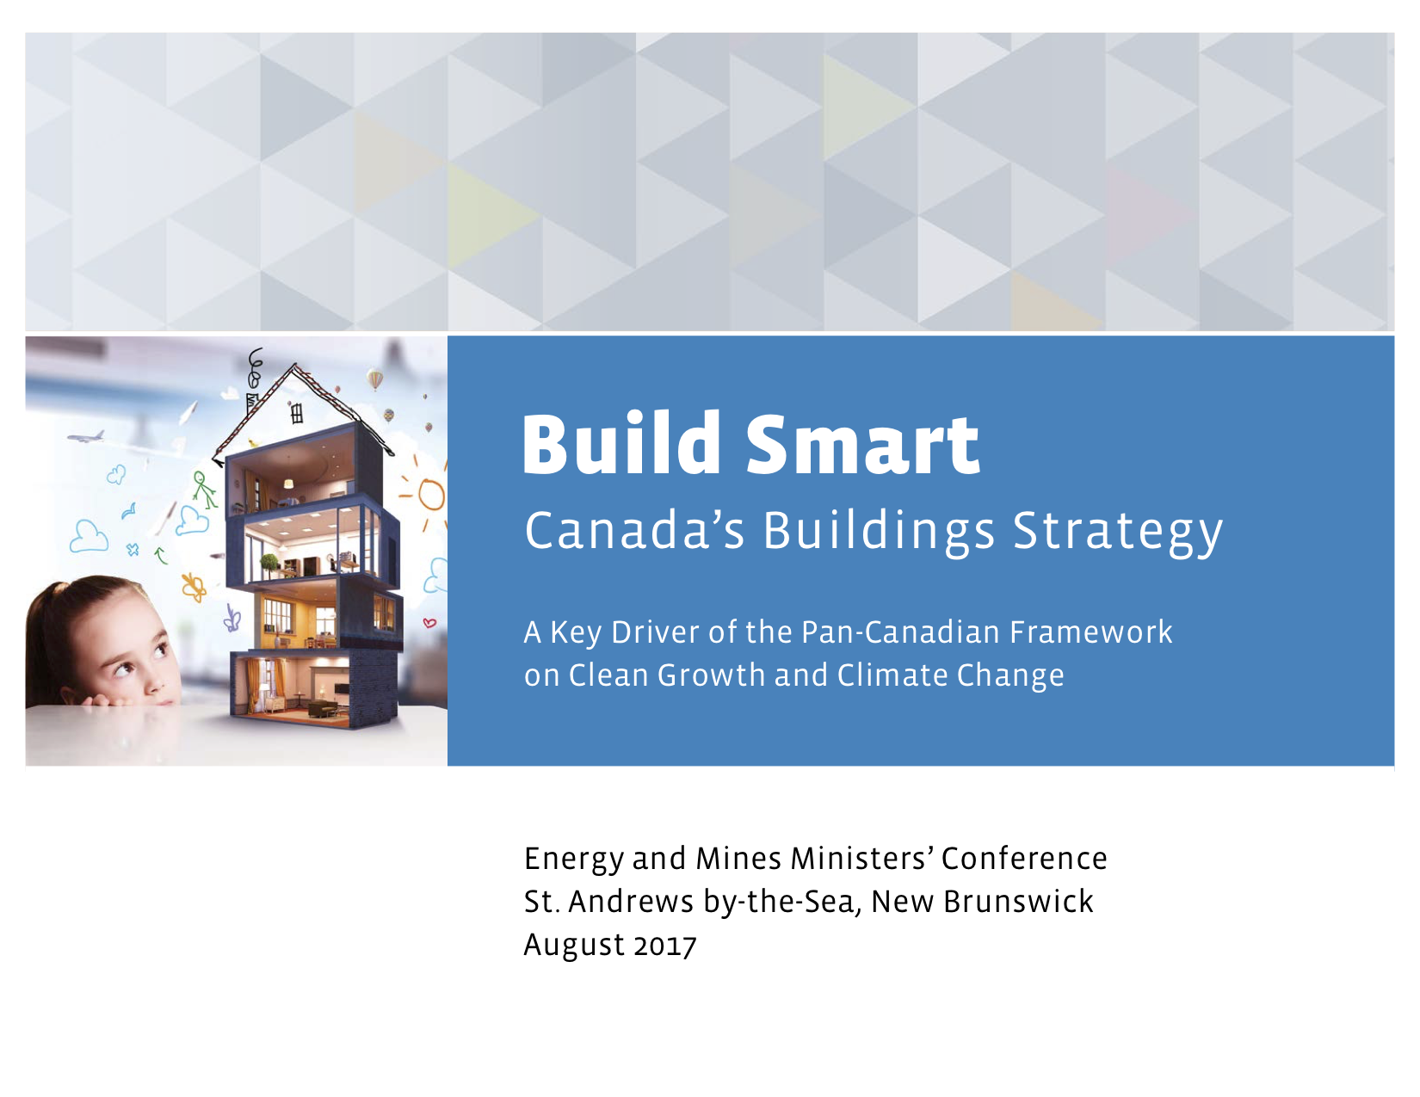
The Provincial Context
Federal Policy Context
August 2017
“Federal, provincial, and territorial governments will work to develop and adopt increasingly stringent model building codes, starting in 2020, with the goal that [all] adopt a net-zero energy-ready model building code by 2030.”
Notes:
In 2017 the Government of Canada released Build Smart: Canada’s Buildings Strategy

Slide 4
The Provincial Context
Provincial Policy Context
December 2018
Notes:
In December 2018, the province released its Clean BC strategy, which reaffirmed the Net Zero Energy Ready target and established new interim deadlines.
First deadline is 2022, when new homes must perform 20 percent better than those built to the requirements of the 2018 BC Building Code.
There is a subsequent deadline in 2027.

Slide 5
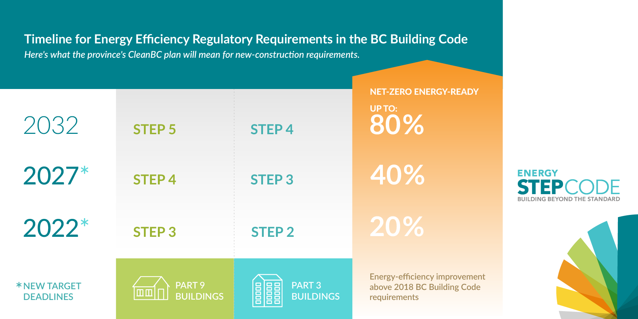
The Provincial Context
Roadmap to Net-Zero Energy-Ready Buildings
Notes:
First deadline is 2022, when new homes must perform 20 percent better than those built to the requirements of the 2018 BC Building Code.
There is a subsequent deadline in 2027.

Slide 6
Energy Step Code Council
Industry
Government
Utilities
Academia & NGO
Notes:
In 2017, the Province of British Columbia established the Energy Step Code Council to support the successful implementation of the BC Energy Step Code and the market transition to net-zero energy ready buildings.
A representative of the Province of British Columbia’s Building and Safety Standards Branch chairs the Council. Government, industry, and utility stakeholders serve as Council representatives
As an advisory body, the Council does not have any formal regulatory or administrative authority. Instead, it provides a venue for stakeholders to gather and share information, and work collaboratively to resolve issues as they arise. Informally, it serves as a “bridge” between the provincial government, utilities, local governments, and the building, development and design sectors, to help local governments adopt the BC Energy Step Code in a prudent and coordinated manner.
The Province of British Columbia works with the Energy Step Code Council to monitor how local governments are implementing the standard, including any impacts on housing affordability and technical building requirements. Issues identified by the Council may inform future changes to the technical content of the regulation, or how it is implemented.

Slide 7
How the BC Energy Step Code Works (Part 9)
Notes:
Here is how the BC Energy Step Code works.
Step 1 tightens up requirements, making builders pay attention to details and ensuring a quality building envelope. Step 1 requires performance testing of the building during construction to ensure that the building envelope is well-sealed.

Slide 8
How the BC Energy Step Code Works (Part 9)
Notes:
Once buildings are being measured for performance (Step 1), the middle steps actually require higher performance levels.
There are already many buildings constructed at these Steps in BC through industry leadership and local government policy.
To achieve the Lower Steps, building and design professionals and trades can rely on conventional building designs with careful air-sealing practices, and incrementally incorporate some key elements in the design, building envelope, and equipment and systems.
Builders and designers are advised to collaborate with their energy advisor to select the most cost effective way to meet the requirements.

Slide 9
How the BC Energy Step Code Works (Part 9)
Notes:
For Part 9 buildings, Step 4 marks the beginning of the Upper Steps.
To achieve the Upper Steps, builders and designers will need to adopt a more integrated approach to building design and may need to incorporate more substantial changes in building design, layout, framing techniques, system selection, and materials.
These techniques and materials will be more costly and challenging without additional training and experience.
For this reason, the province is advising local governments that they may incentivize the Upper Steps, but may not require them community wide until at least 2020.
This is to allow industry time to increase capacity.

Slide 10
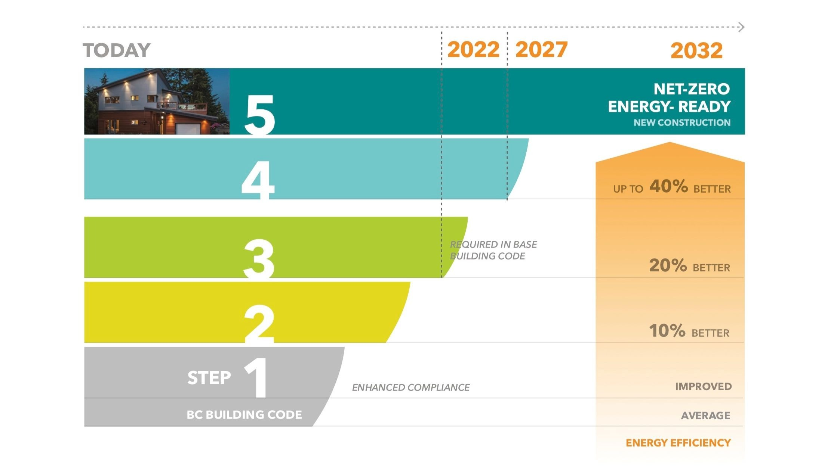
How the BC Energy Step Code Works (Part 9)
Notes:
The top step in the BC Energy Step Code equates to a Net Zero Energy Ready building, which is up to 80 percent more energy efficient than a typical new building.
In 2032 the code will require this level of performance in all new buildings.
Such buildings roughly approximates the requirements of the Passive House standard, or the CHBA’s Net Zero Ready certification.

Slide 11
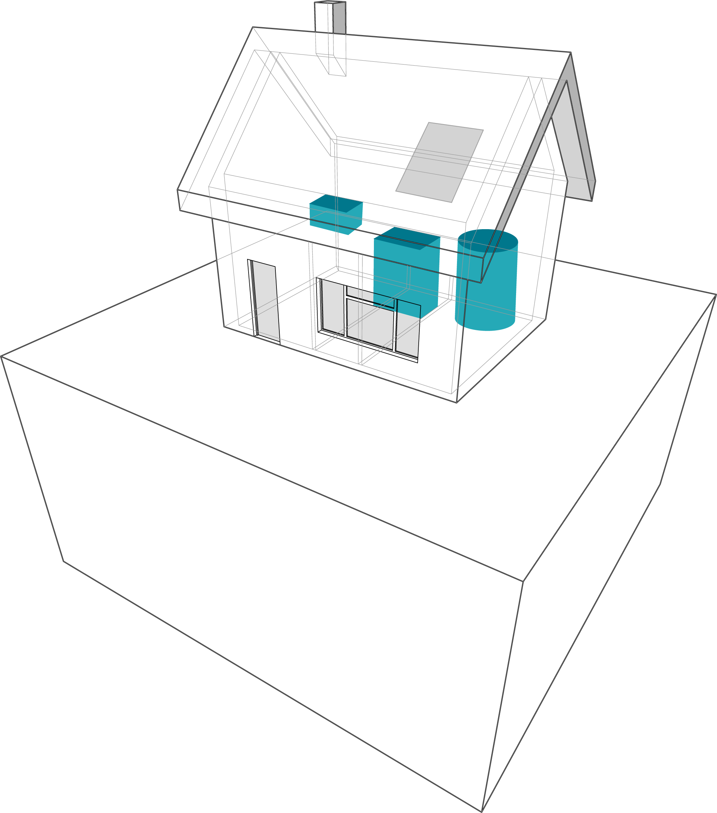
What does the Energy Step Code Measure (Part 9)?
Energy Step Code – Overview
‘Energy Efficiency’ in the Energy Step Code:
Envelope Efficiency
Equipment Efficiency
Performance based

Slide 12
Metrics - Envelope Efficiency
Energy Step Code – Overview
Losses
Air tightness
Insulation
Gains
Solar gain
People & equipment
Units of heat energy required for constant temperature after losses and gains (ignores equipment efficiency).

Slide 13
Metrics - Equipment Efficiency
Energy Step Code – Overview
Energy Use
Heat
Water heating
Ventilation
Lights and plug loads (large buildings only)
Energy Use

Slide 14
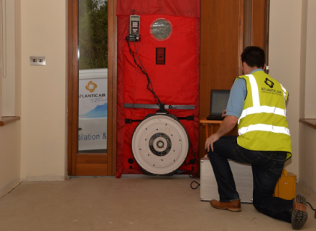
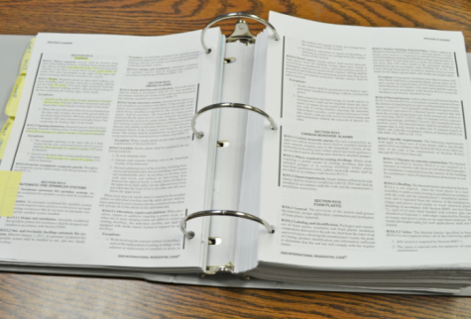
Performance Compliance
Energy Modeling by Natural Resources Canada Certified Energy Advisor
Air-Tightness Testing
Achieve minimum performance levels
No Prescriptive Energy Requirements

Slide 15
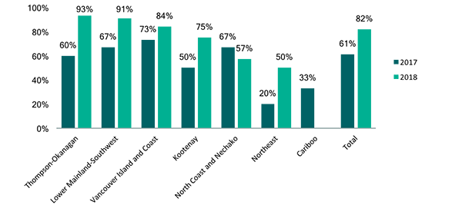
Local Government Awareness
Local governments with “moderate,” “good,” or “excellent” knowledge of the BC Energy Step Code, 2017-2018.
Notes:
More info: find Local Govt awareness surveys here: https://energystepcode.ca/publications/

Slide 16
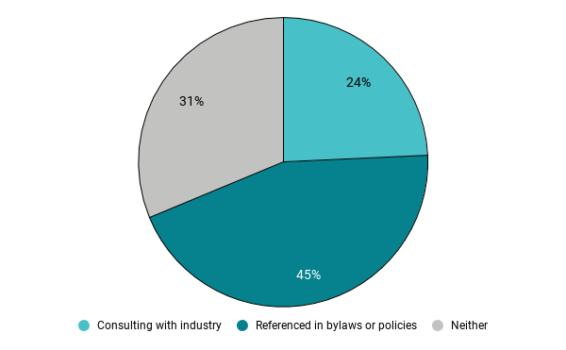
Local Government Adoption in Bylaws
Policy in Practice:
Communities that collectively issue 45% of all building permits have referenced the BC Energy Step Code in bylaws.
Notes:
This chart is data as of September 2018.
Based on 2017 building-permit data, close to half of all new construction will be subject to one or more “steps” of the standard in 2019. Further, if all the communities that are thinking of putting the standard to work choose to do so, more than two-thirds of all new construction will exceed the current BC Building Code energy-efficiency requirements.
More info: https://energystepcode.ca/implementation_updates/

Slide 17
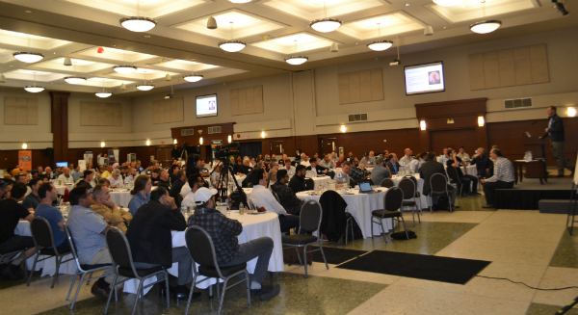
Industry Capacity Building Workshops
Building Smart
BC Housing series.
Hundreds of builders trained, all over B.C.
LEEP Sessions
Builder engagement workshops.
Two sessions in three regions.

Slide 18
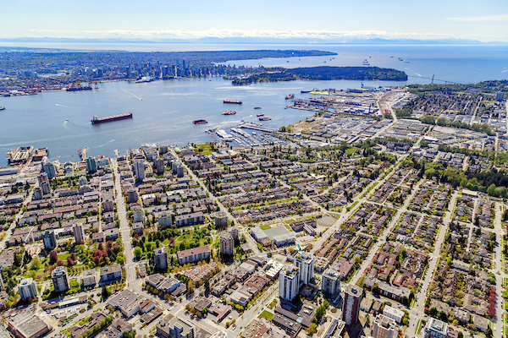
Implementation – Contiguous Local Governments
Aligning timelines and requirements
Notes:
A number of adjoining British Columbia communities have worked together to adopt identical BC Energy Step Code strategies. This “regional alignment” approach helps reduce paperwork for builders active in these communities by establishing uniform timelines and requirements across a broad geographic area.
The District of West Vancouver, the City of North Vancouver, and the District of North Vancouver required all builders to meet the requirements of Step 3, Part 9 and Step 2, Part 3 on July 1, 2018
These communities on the North Shore of Metro Vancouver are are home to about 180,000 residents, and will host a good deal of development activity in the coming years.
The District of Squamish and the Resort Municipality of Whistler soon followed suit, extending what had become a de facto Efficient New Home Zone beyond the North Shore and up the Sea-to-Sky Corridor.
Further, adjoining local governments in the Capital Regional District adopted a similar approach on Southern Vancouver island. All of these local governments have made life a little easier for builders who once struggled a patchwork of energy requirements across the region.

Slide 19
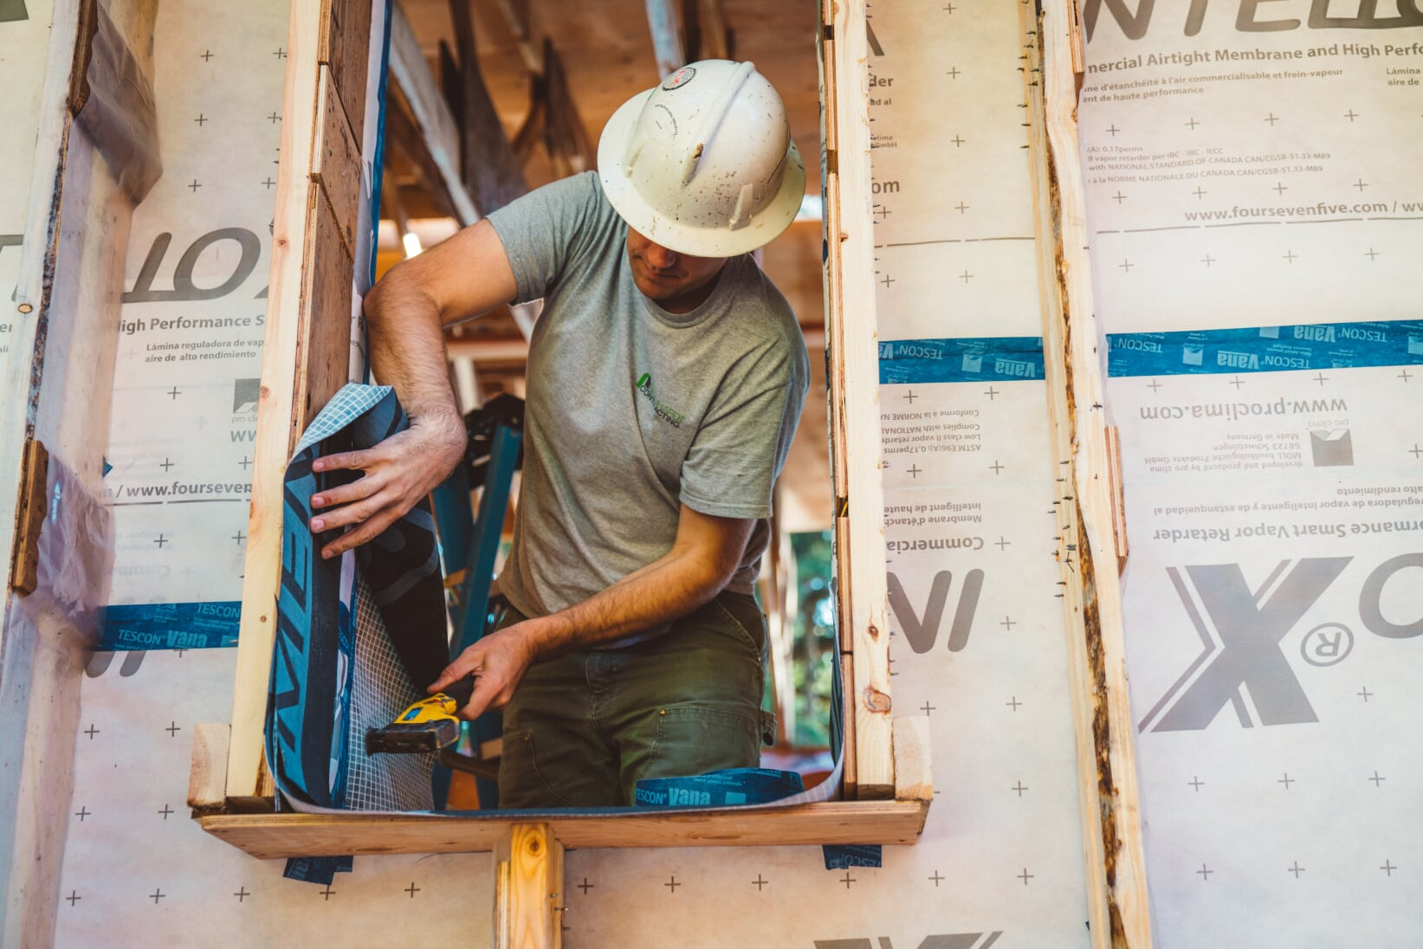
Implementation – Removing Zoning Barriers
Relaxing
allowable floor area, height, and setback requirements
Notes:
Local governments use zoning bylaws to dictate minimum and maximum requirements for a new building’s allowable floor area, height, and setbacks. Unfortunately, the rules often unintentionally disadvantage those who wish to voluntarily built to Upper Steps of the BC Energy Step Code.
The issue? A Part 9 home built to meet the requirements of the Upper Steps will generally have slightly thicker walls, and for the top step, a deeper insulated roof. Typical floor-space rules, which dictate density allowed on a given lot, may force builders to sacrifice allowable floor area to insulation, creating a disincentive. Numerous local governments are identifying these zoning barriers to high performance buildings, and lowering them via housekeeping amendments.
Following similar updates by the Resort Municipality of Whistler, the City of North Vancouver, and the City of Vancouver, in early 2018 the City of New Westminster amended its zoning bylaw to exempt the area occupied by additional wall insulation for single-detached homes that achieve Step 3, 4, or 5 for single-detached homes, including detached dwellings such as laneway and carriage homes.
For single detached homes achieving Step 5, the city also relaxed maximum building heights by up to 1.22 meters (4 feet), to support deeper insulation in the roof assembly and foundation. At time of publication, city staff were also reviewing whether similar exclusions and relaxations would also be appropriate for duplexes, triplexes, townhomes, and similar ground-oriented Part 9 multi-unit residential buildings.

Slide 20
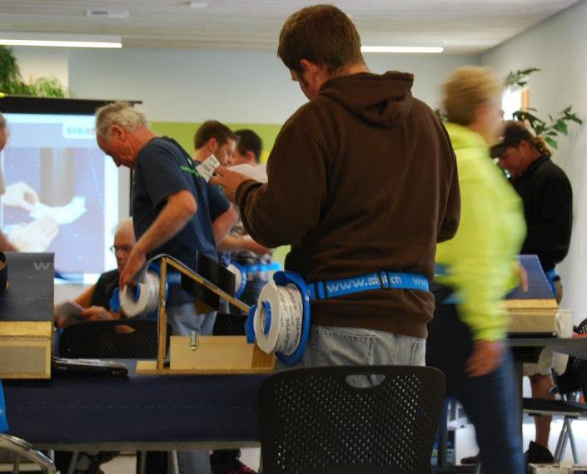
Implementation – Supporting builders
Air barrier installation training
Notes:
The City of Vancouver offers a textbook example of how a local government can support its builders as they adapt to new performance-based codes such as the BC Energy Step Code.
In early 2015, the city began enforcing specific air-tightness requirements for new homes—but many builders lacked the skills and knowledge needed to comply.
As a result, at least at first, plenty fell short of the mark. In response, the city offered to relax enforcement of its air-tightness rule on non-complying projects, so long as the builder in question paid for, and had at least two staff attend, a one-day course on installing effective air barriers.
In March 2019, with a significant percentage of its builders up to speed, the city began rigidly enforcing its air-tightness requirement. And 100+ builders have acquired new skills that will serve them well in the transition to net-zero energy-ready or zero-emissions construction.
Both the City of Surrey and the City of Richmond have instituted a similar opportunity for builders who do not meet air-tightness requirements on their projects.

Slide 21
Communications
“One-Stop-Shop” website (energystepcode.ca)
Guides, handbooks, videos for local governments and industry.
Metrics Research Report
Search for energy advisors, incentives.
Ongoing Updates
Monthly opt-in newsletter.
https://mailchi.mp/energystepcode/subscribe
Social media updates on Twitter, Facebook, LinkedIn.
Notes:
The Energy Step Code Council, the Province of British Columbia, BC Housing, and other organizations have produced a variety of resources to support industry and governments through the transition to net zero energy ready buildings. It’s all at energystepcode.ca.
The Energy Step Code Council also produces a monthly newsletter, and posts updates on social media.

Slide 22
Thank You!
Questions?
Firstname Lastname
Title
City of Surrey
Contact Info

Slide 23
Additional Slides

